Slide 1

Real Estate Market
Covid-19
Authors:
Emilia Lubanska, Jorge Arriola, Marina Ercoli, Monica Lin, Ulisses Pinto

Slide 2
Motivation & Summary
Curiosity
To analyse the impact of Covid-19 on the real estate market comparing 2019 and 2020 data from GTA.
Exam correlations, changes on interest rates as well as prices fluctuations sorting by types of houses/properties.
Questions & Why
What is the impact of Covid-19 on the real estate market?
Does it impact the interest rates?
Is there any correlation between Covid-19 and the volume of sales?
What types of the houses being sold (condo, detached etc.)
What about price fluctuation?

Slide 3
Motivation & Summary
Outcomes
- Very weak correlation between the data sets
The correlation between mortgage rate and cases is pretty strong
The real estate market in Ontario is strong for the past 12 months
Core message & Hypothesis
CM: To analyze the impact of Covid-19 on the real estate market in Ontario.
Hypothesis: We believe that indicators related to the real estate market will have a lower performance in 2020 than in 2019. (e.g. less houses sold in 2020 than in 2019)

Slide 4

Questions & Data
Questions
Number of Covid-19 cases
Fluctuation of house price
Number of houses sold in Ontario per month
Mortgage rate fluctuation
Covid-19 cases Vs. interest rate
Covid-19 cases Vs. house sold
Covid-19 cases Vs. house price
Data Sources
Websites:
open.canada.ca ----- CSV
data.ontario.ca ----- JSON
quandl.com ---------- API
bankofcanada.ca ---- CSV

Slide 5
Questions & Data
Data Sources
Canada Mortgage and Housing Corporation, housing under construction in all centres 10,000 and over for Canada, provinces, and selected census metropolitan areas https://open.canada.ca/data/en/dataset/1995a476-68fd-4fe2-973f-2dd47f7f6c2c
Confirmed positive cases of COVID19 in Ontario
https://data.ontario.ca/dataset/confirmed-positive-cases-of-covid-19-in-ontario/resource/455fd63b-603d-4608-8216-7d8647f43350
Average, Median and Price Percentiles for Unabsorbed Homeowner and Condominium Units (Provinces) – Ontario
https://www.quandl.com/data/CMHC-Canadian-Mortgage-and-Housing-Corporation/documentation?anchor=about
Canadian Interest Rates and Monetary Policy Variables: 10-Year Lookup
https://www.bankofcanada.ca/rates/interest-rates/canadian-interest-rates/

Slide 6
Data Cleanup & Exploration
Cleanup process
Based on the main data frame, create a new chart that only includes the information we need
Retrieve Data
Create data frames
Note: We all agreed to create a column named ‘Date’ with the same format for all datasets. Allowing us to grouping the datasets easily.

Slide 7
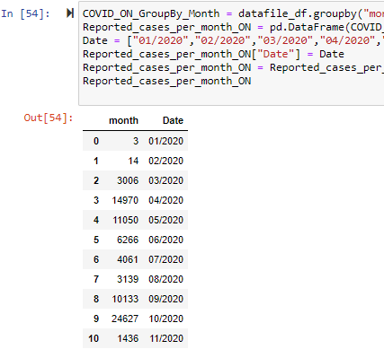
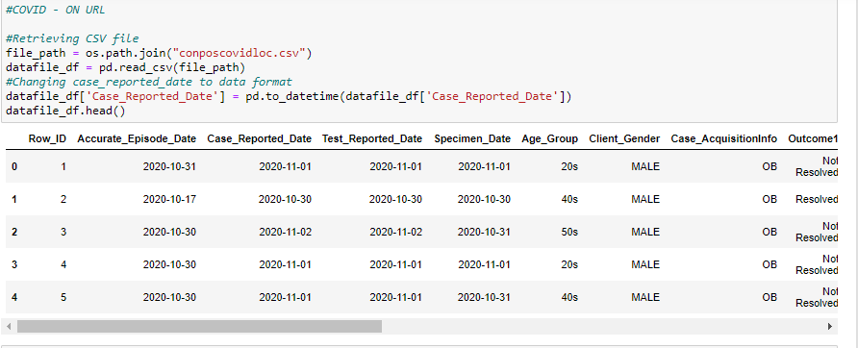
Data Cleanup
Before
Now

Slide 8
Data Cleanup & Exploration
Exploration
1st Step > We leveraged some sources provided by the government and banking institutions: - Open.canada.ca
- Data.ontario.ca
- Bank of Canada
2nd Step > It was to find a dataset that kept track of how the value of houses in Toronto has fluctuated in time.

Slide 9
Exploration
Insights while exploring the data that you didn't anticipate:
Insights > From a visual inspection, we noticed that the number of buildings being constructed in Ontario in 2019 and 2020 were very similar. Hence, Covid-19 did not seem to have a direct impact on this
Problems that arose after exploring data | How we solve them:
Problems >

Slide 10
Exploration
Interesting figures developed during exploration:
Final Jupyter Notebook
Figures Summary

Slide 11
Data Analysis
Steps to analyze the data and answer proposal questions:
………
……….
Interesting figures developed during analysis :
Final Jupyter Notebook

Slide 12
Discussion
Findings:
………
……….
Inferences | General conclusions:
………
……….

Slide 13

Post Mortem
Difficulties that arose, and how we dealt with them:
………
……….
Additional questions | What would we research next?
………
……….

Slide 14

Q&A with the audience

Slide 15
Thank You!
Our photo to be added
Covid-19
Emilia Lubanska, Jorge Arriola, Marina Ercoli, Monica Lin, Ulisses Pinto

